Slide 1
Streaming
Langchain offers streaming service with two options
With Callback
Without Callback

Slide 2
Callbacks
Callbacks are hooks which are called on specific events
For ex: on_llm_new_token in BaseCallbackHandler gets called whenever new token is generated

Slide 3
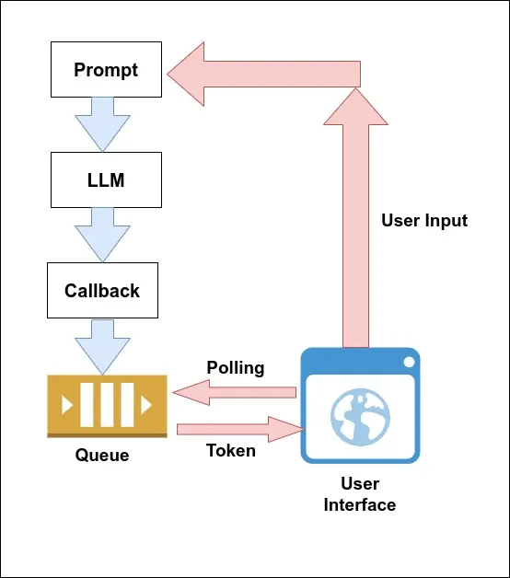

Slide 4
Using LCEL
Create the Conversational Retrieval chain using LCEL and use `astream` instead of `invoke` to stream the data

Slide 5
Gradio
Helps to build and share the Machine Learning / Generative AI data.
Provides chatbot interface with few lines of code

